Slide 1


Slide 2

Setting some terms
Spend your time here
User Interface (UI) | User Experience (UX)
Typography | Information architecture
Colors | Wireframing
Button shapes | Visual hierarchy/order
Images | User stories, user flows
Gewgaws, flim-flam, glitter | Testing

Slide 3
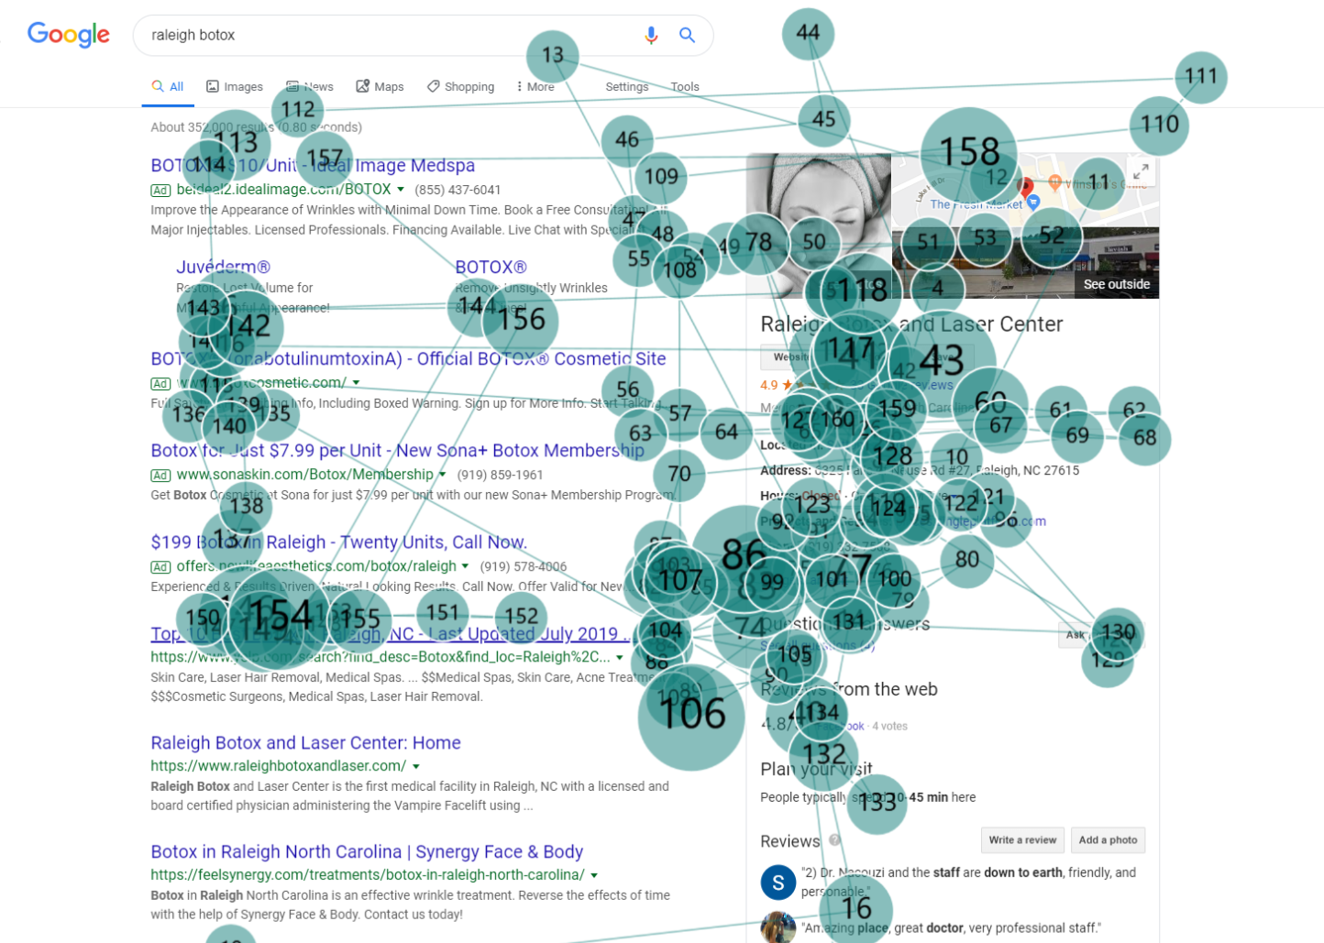
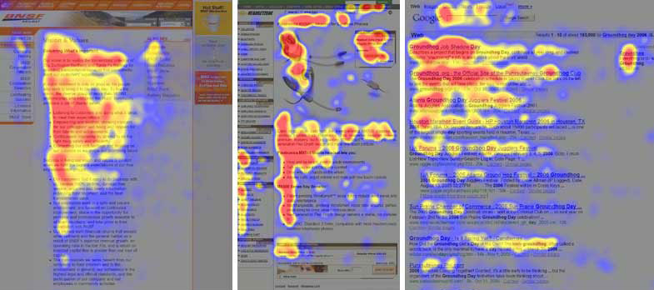
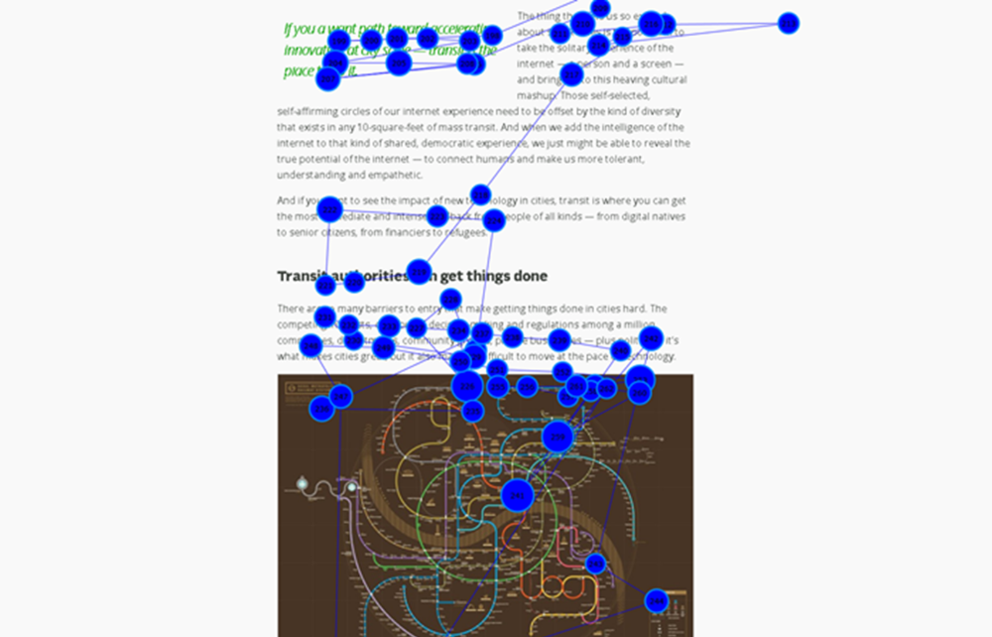
F Pattern
Pinball pattern
Fundamentally, page readers scan; they don’t read.
Layer Cake Pattern

Slide 4
4 Factors influence web information consumption:
Level of Motivation
Type of Task
Level of Focus
Personal Reading Habits

Slide 5
Know your users
Novice | Expert
Use menus to separate functions | Make commands available over menus
Keep interface simple, general | Specialize to suit specific need(s)
Emphasize single tasks | Emphasize power in system

Slide 6
Rules for designing simple interfaces
Place user in control
Reduce user’s need to memorize or pay attention too closely
i.e. Users make mistakes; often many
Establish consistency

Slide 7
User control
Don’t use multiple “modes”; one mode per screen
Make operating mode visible
Are user’s editing? Just reading?
Offer many ways to go back or undo
Hide technical details

Slide 8
Reduce user need for memory/attention
Establish defaults based on habits/patterns
Define and keep shortcuts consistent
Prompt user to recognize, not remember
Here, use toolbars, drill-downs, tabs
Provide action “audit trails”

Slide 9
Establish consistency
Show application state or “mode” in the same place everywhere
Set uniform visual interface standards, language
Default to the idea that the system should explain its own use

